Slide 1
Launch of HealthCheck for TeacherConnect
A WhatsApp based support service for SA’s teachers
September 2020

Slide 2
Learning has evolved…
And so have we. With this platform, the DBE can now reach teachers in the place 2 billion people visit every day - WhatsApp!
TeacherConnect Evolution of learning
Print
Television
SMS
Social
Chat

Slide 3
Introducing TeacherConnect
A platform to benefit the education system, teachers and learners alike.

Slide 4
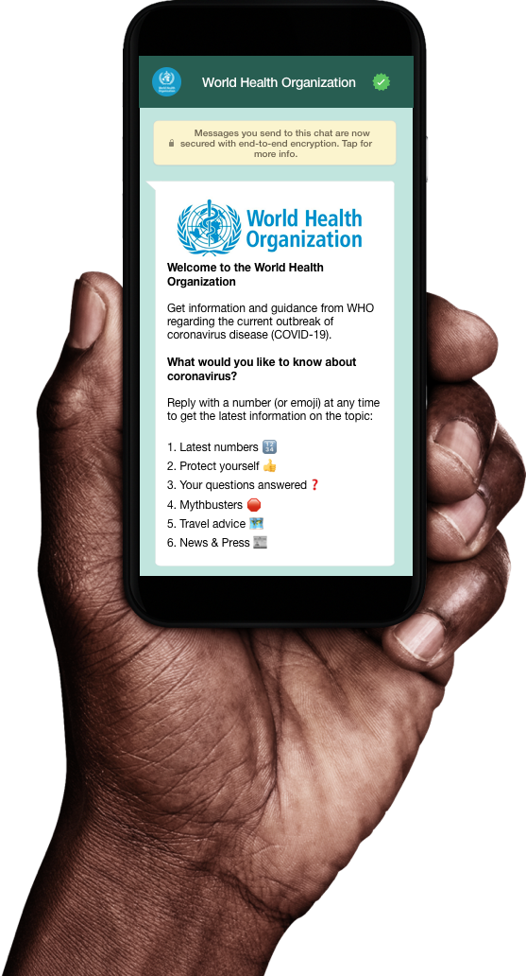
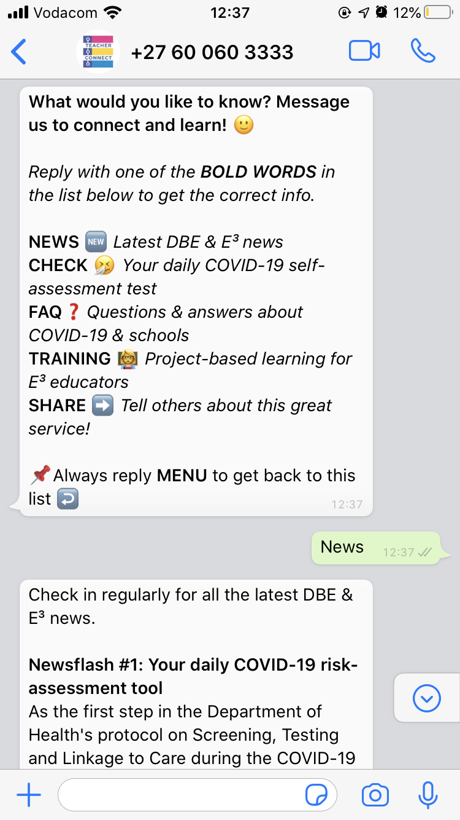
TeacherConnect
TeacherConnect the service
TeacherConnect
TeacherConnect is a free real-time chat-based learning and mentorship platform for teachers, learners & education.

Slide 5
TeacherConnect - The Vision
TeacherConnect
Connect - Providing a WhatsApp chat-based, mobile support line available 24/7 to all teachers
Helpdesk - AI-powered helpline providing immediate answers and links to information
Learning - Curriculum of E3 pedagogy in mobile format accessible via WhatsApp
Mentoring - Coaching and peer-based support and guidance
Tracking - Real-time dashboards

Slide 6
Self-screening with HealthCheck
Integrates with TeacherConnect to ensure effective management of Covid-19 in the educational system.

Slide 7
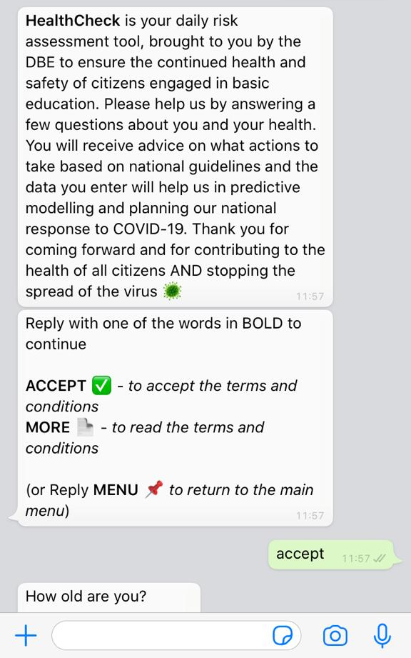
TeacherConnect and HealthCheck
TeacherConnect
To help ensure the safe reopening of schools TeacherConnect has integrated with HealthCheck -
a National Department of Health self-screening initiative.

Slide 8
HealthCheck
TeacherConnect and HealthCheck
TeacherConnect
This COVID-19 Digital Risk Assessment and mapping tool, HealthCheck, allows for early detection, mapping, management and pre-screening of COVID-19 cases.

Slide 9
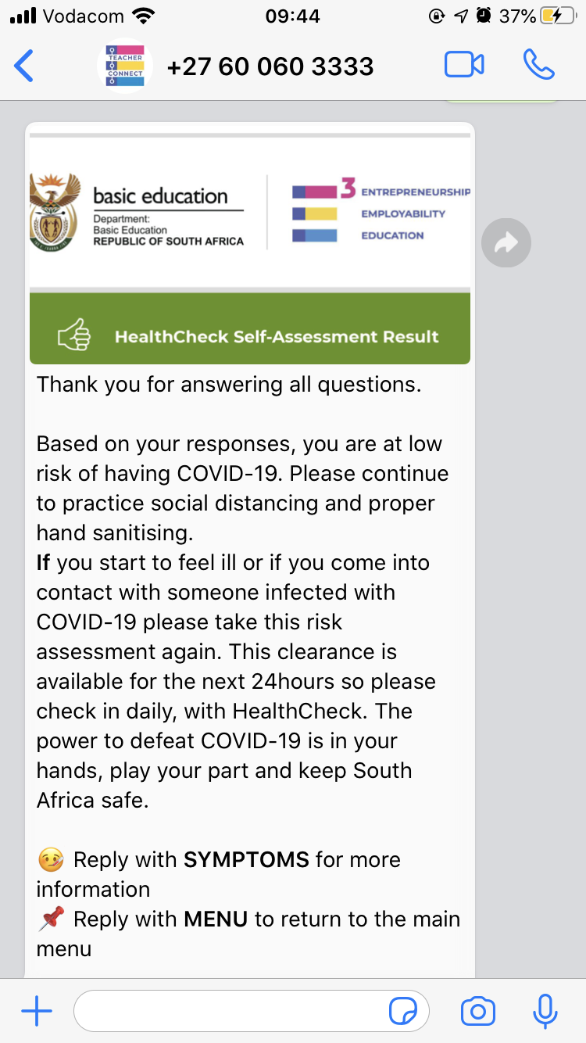
TeacherConnect self-screening with HealthCheck
TeacherConnect
As educational facilities reopen performing a daily self pre-screening will be a critical step in reducing the spread of COVID-19.

Slide 10
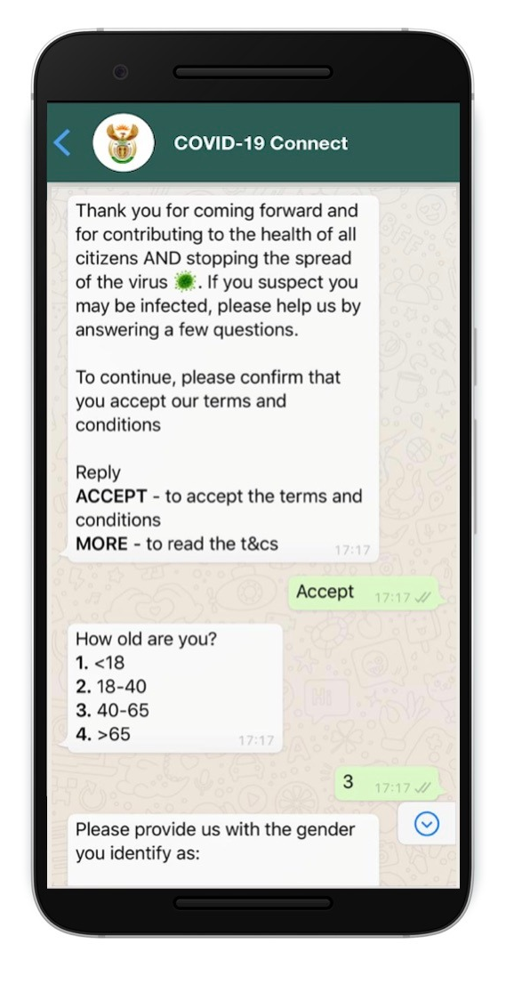
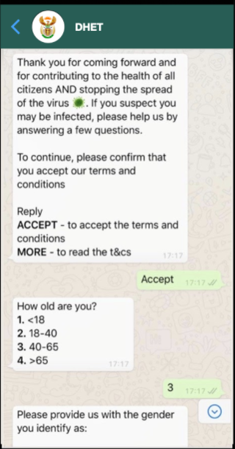
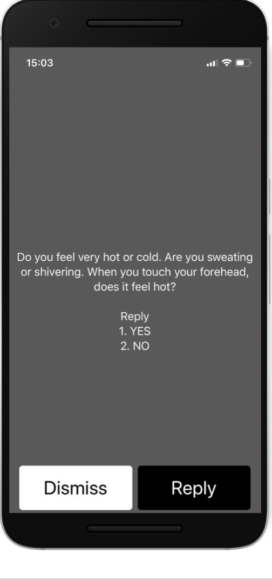
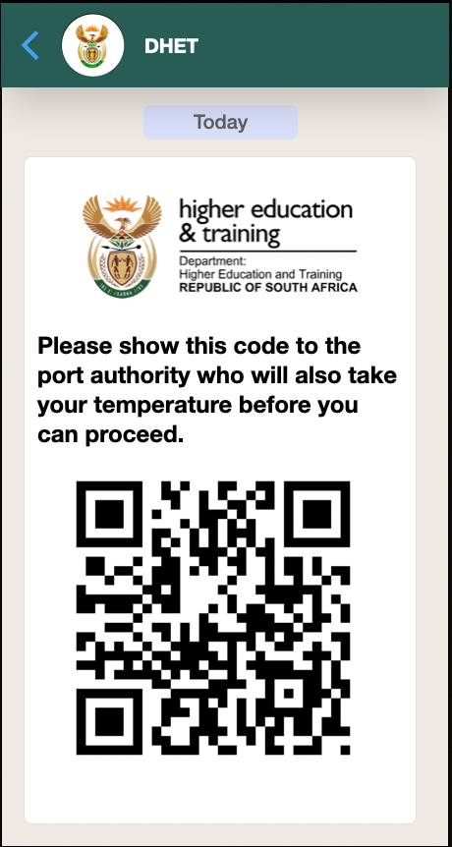
TeacherConnect and HealthCheck
Step
1
Step
2
Step
3
Step
3
Daily Screening
Risk Classification
Verification
Follow Up
Teachers will be encouraged to do a daily HealthCheck through their channel of choice.
Once the check has been completed, actions are suggested based on NICD and NDOH guidelines.
SELF ISOLATE
TEST
SEEK EMERGENCY CARE
Before entering campus, students and staff must show that they have completed the daily HealthCheck and are cleared to continue onto campus.
For those students and staff who have been classified as moderate or high risk, they will be entered into the NDOH tracking and tracing process.
Higher Health
Higher Health

Slide 11
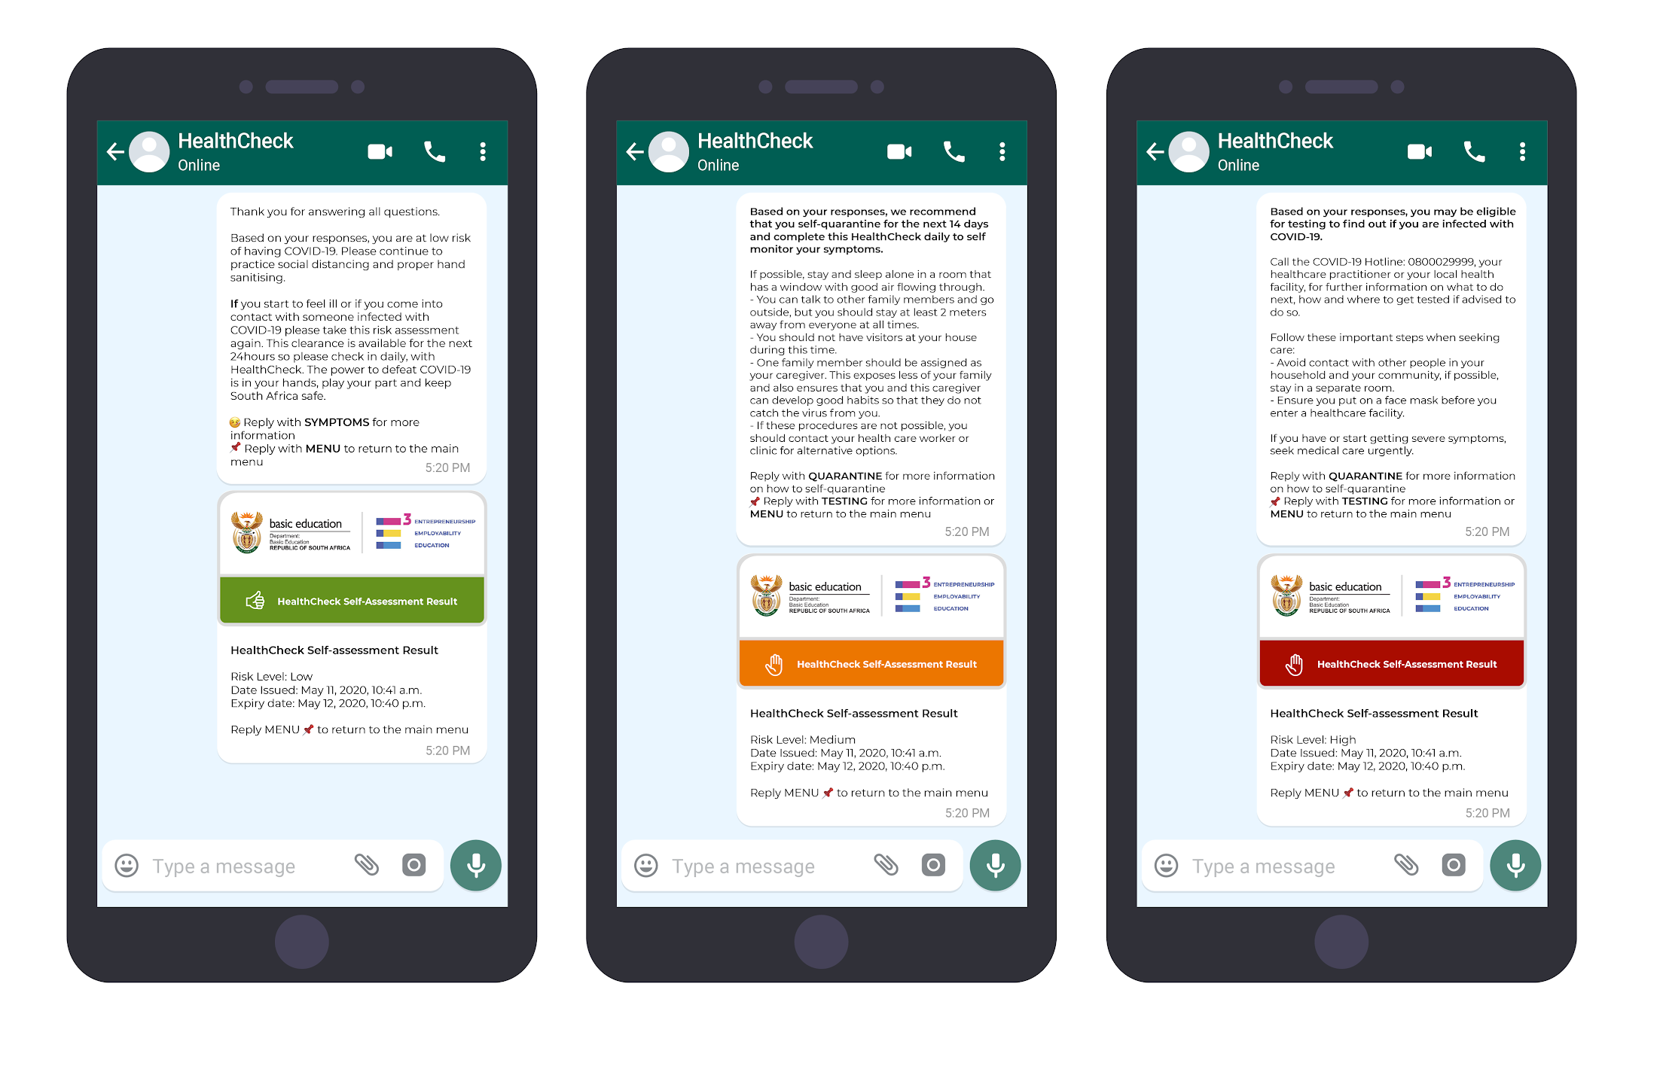
TeacherConnect receipts with HealthCheck
Digital Results generated from self pre-screenings give individuals (learners, educators, support staff etc.) an endorsed declaration of their risk level with a validity period of 24 hours.
Clearance Receipts issued for Low Risk
Clearance Denied for Medium Risk
Clearance Denied for High Risk

Slide 12
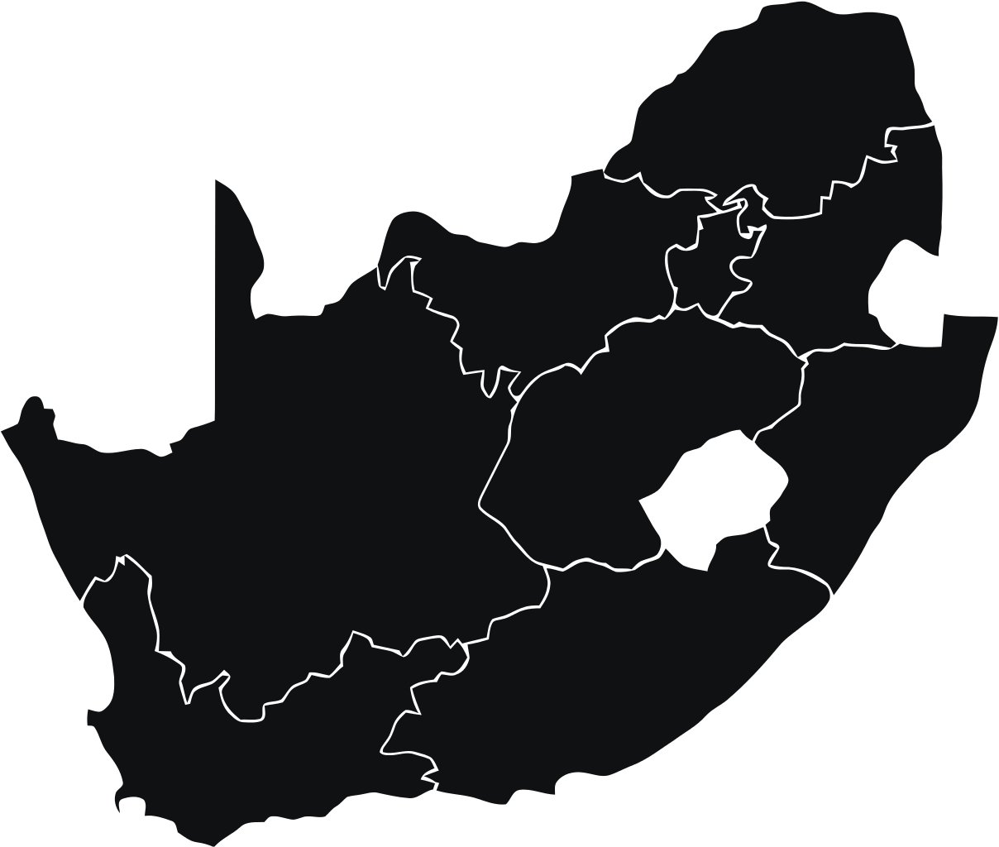
TeacherConnect reporting dashboards
Total HealthCheck users
HealthCheck Risk levels
1,569,748
HighRisk
MidRisk
Current HealthCheck platform usage
LowRisk
60% USSD (sms)
40% WhatsApp
Self-Assessments to date
4,547,410
HealthCheck Performance | 25 August 2020

Slide 13
TeacherConnect How it works
Video demo of HealthCheck
Just send “check” to
+27 60 060 3333 to self-screen with TeacherConnect now!
Check in daily to help keep your school community safe!

Slide 14
Brought to you by E³
Assisting teachers in equipping our future generations
Notes:
This will be about 5 or 6 slides.

Slide 15
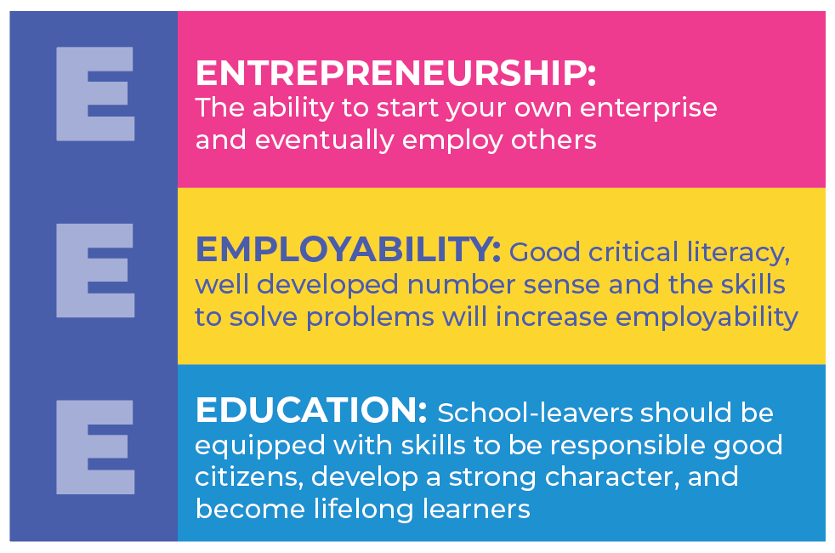
TeacherConnect E³ and the DBE
E³ is an initiative of the DBE that uses student-centered active learning (including projects and games) in the CAPS curriculum to assist teachers to better prepare learner for the modern economy.

Slide 16
TeacherConnect
TeacherConnect
Just send “hi” to
+27 60 060 3333 to self-screen with TeacherConnect now!

Slide 17
THANK YOU
A WhatsApp based support service for SA’s teachers
September 2020

